Slide 1
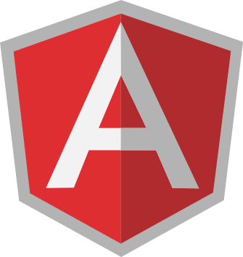
Angular JS Template and Controller s

Slide 2
Agenda
Getting started
Controllers
Interaction

Slide 3


Slide 4
Introduction to SPA
What is Single Page Application (SPA),
Difference between AngularJS and Angular

Slide 5
What is Angular?
Angular (formerly called Angular JS) is a typescript based web application framework that supports full-stack development for building all types of web applications.
It helps in creating reactive single page application (SPA) and is completely based on the concept of components.
Angular is owned by Google, and its stable version was released on September 14, 2016. Angular's official website is https://angular.io/.
Google makes sure that they release a major version of Angular every 6 months.

Slide 6
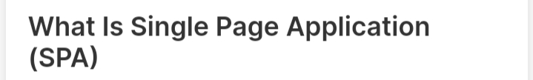
Single-page applications are web applications or a special type of website that provide users with a very intuitive, responsive, and fast user experience.
It is enriched with menus, multiple blocks, tiles, and interactive buttons on one page, helping users easily navigate the application.
This helps to dynamically load a portion of the current page instead of reloading the entire page from the server.
This is why angular based applications are called reactive fast speed loading pages.

Slide 7
Advantage of AngularJS
Dependency Injection: Dependency Injection specifies a design pattern in which components are given their dependencies instead of hard coding them within the component.
Two way data binding: AngularJS creates a two way data-binding between the select element and the orderProp model. orderProp is then used as the input for the orderBy filter.
Testing: Angular JS is designed in a way that we can test right from the start. So, it is very easy to test any of its components through unit testing and end-to-end testing.
Model View Controller: In Angular JS, it is very easy to develop application in a clean MVC way. You just have to split your application code into MVC components i.e. Model, View and the Controller.
Directives, filters, modules, routes etc.

Slide 8
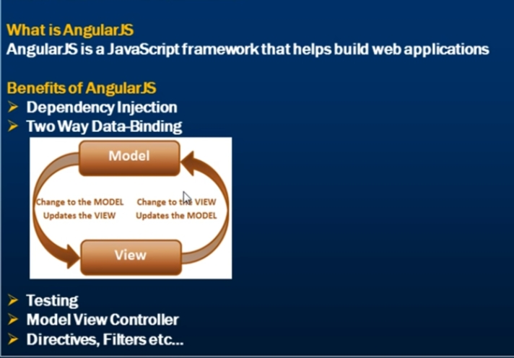

Slide 9
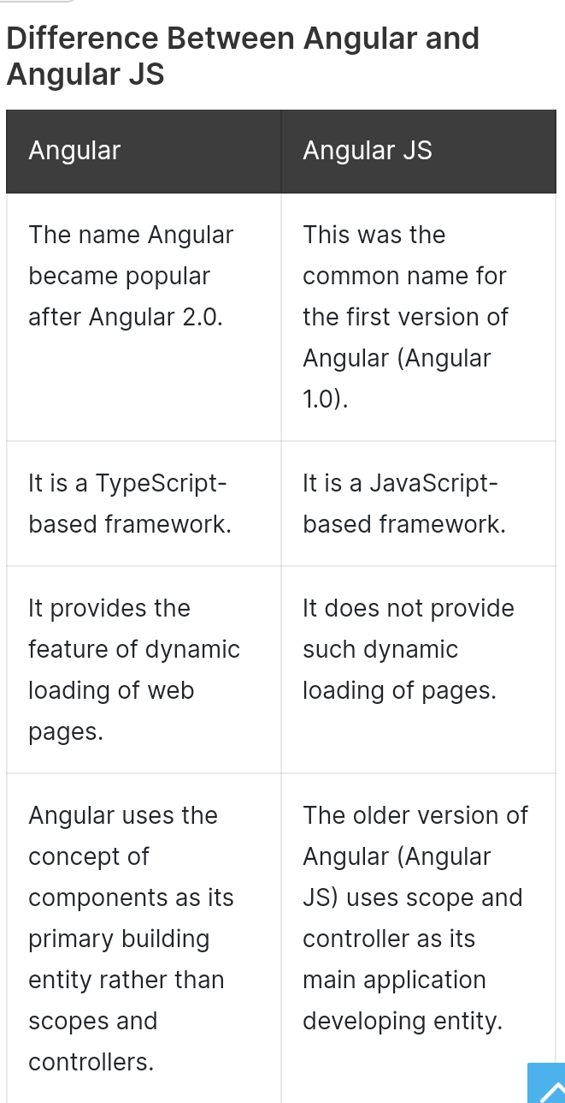

Slide 10
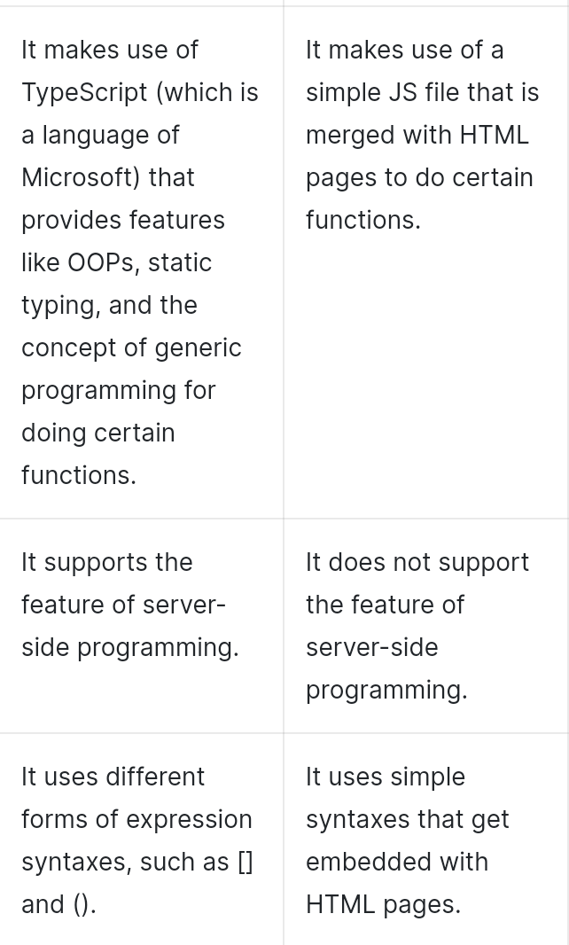

Slide 11
INSTALLATION PROCESS

Slide 12
STEP 1: Install VS CODE
https://code.visualstudio.com/download
STEP 2: Install Node and NPM
https://nodejs.org/en/
check environmental variable
After install nodejs
Go to vb terminal-> new terminal npm install -g @angular/cli@latest
create project
ng new firstApp
(optional)(if error follow https://www.c-sharpcorner.com/article/how-to-fix-ps1-can-not-be-loaded-because-running-scripts-is-disabled-on-this-sys/)
compile file: ng serve
STEP 3: Install Angular CLI
STEP 4:Create First Angular App

Slide 13
Angular CLI
CLI overview,
Commands overview,
Creating a project,
Running a project,
ng add, ng build, ng config, ng new, ng run

Slide 14
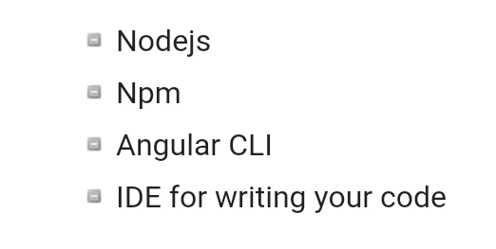
To install Angular 7, we require the following −

Slide 15
Install Visual Studio Code IDE or JetBrains WebStorm or Eclipse IDE
You must have an IDE like Visual Studio Code IDE or JetBrains WebStorm to run your Angular 7 app.
VS Code is light and easy to setup, it has a great range of built-in code editing, formatting, and refactoring features. It is free to use.
It also provides a huge number of extensions that will significantly increase your productivity

Slide 16
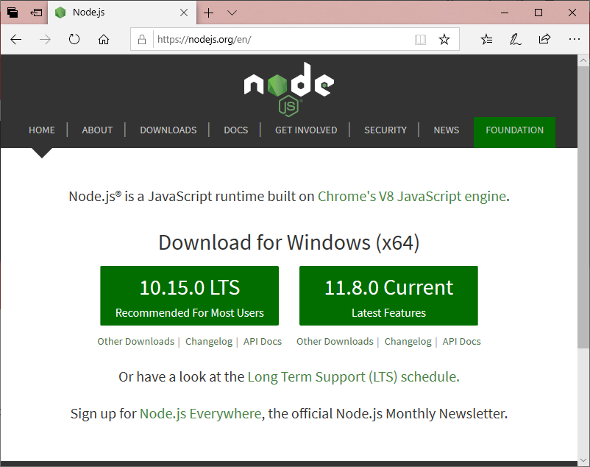
Install Node.js
You should install node.js to run your Angular 7 app. It manages npm dependencies support some browsers when loading particular pages.
It provides required libraries to run Angular project. Node.js serves your run-time environment as your localhost.

Slide 17

Use npm to install Angular CLI
The Angular CLI (command-line interface) is a great tool to efficiently build Angular application by automating operations in Angular projects rather than manually.
Run the Angular CLI command to install Angular CLI

Slide 18
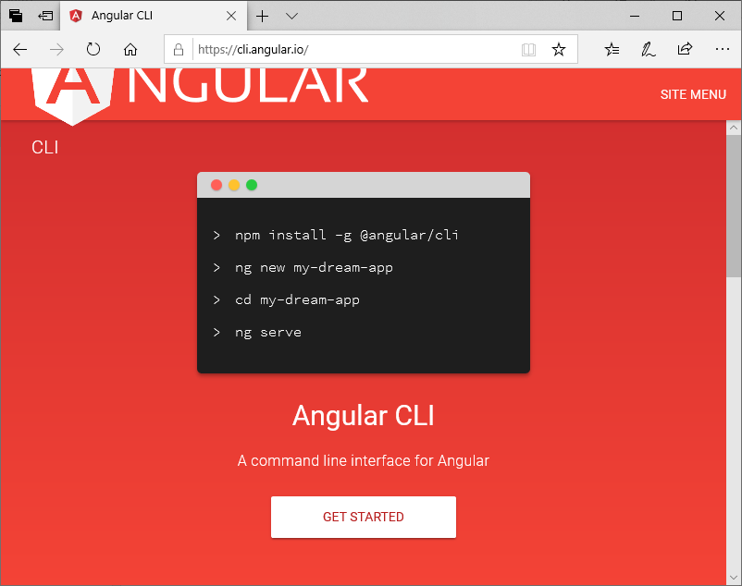

Slide 19
Angular File Structure
Angular Structure,
App Module,
Core Module,
Shared Module,
Feature Modules,
Styles,
Assets

Slide 20
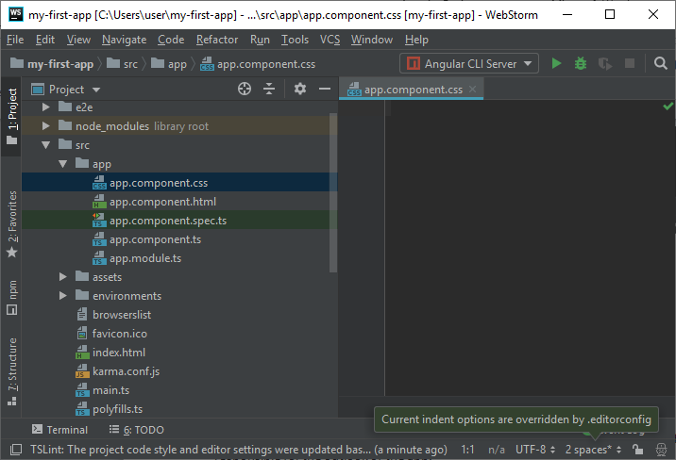

Slide 21
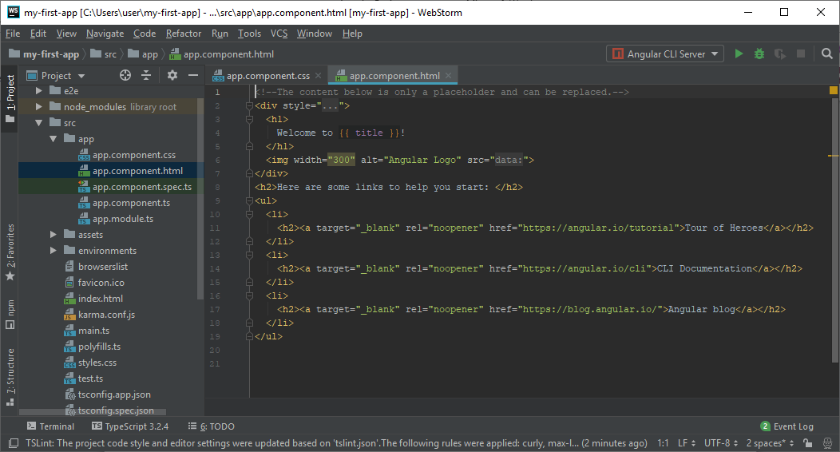

Slide 22
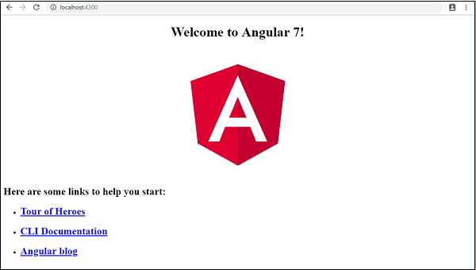

Slide 23
TypeScript
TypeScript vs JavaScript,
Transpilation,
tsconfig.json,
typings

Slide 24
What is JavaScript?
JavaScript is a scripting language which helps you create interactive web pages.
It followed rules of client-side programming, so it runs in the user's web browser without the need of any resources forms the web server.
You can also use Javascript with other technologies like REST APIs, XML, and more.

Slide 25
What is Typescript?
Typescript is a modern age Javascript development language.
It is a statically compiled language to write clear and simple Javascript code.
It can be run on Node js or any browser which supports ECMAScript 3 or newer versions.

Slide 26
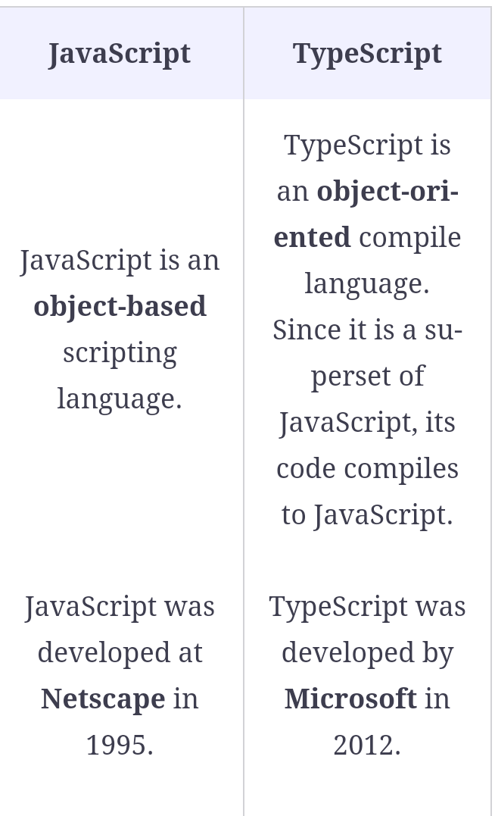

Slide 27
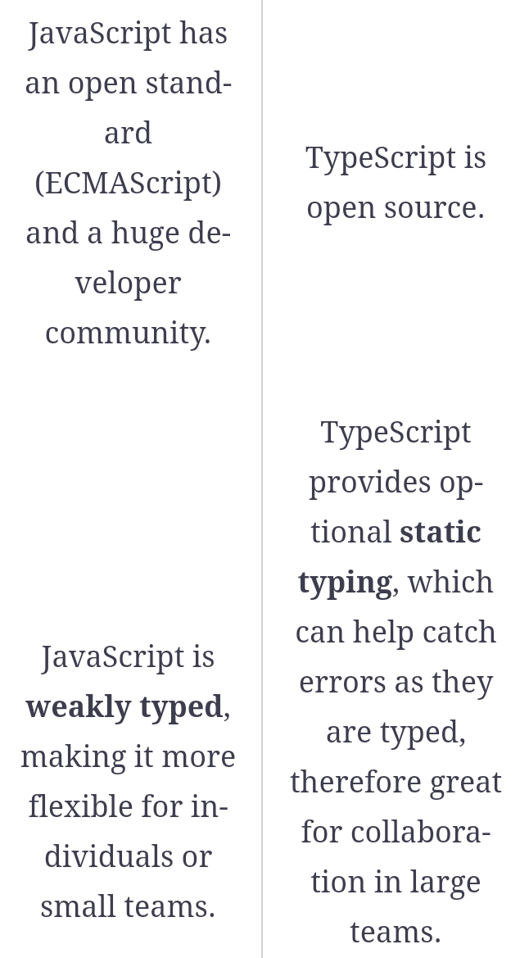

Slide 28
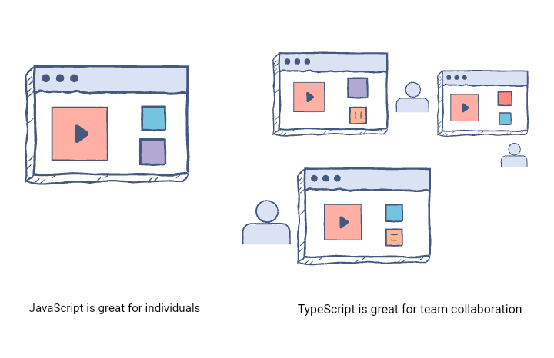

Slide 29
Advantages of using TypeScript over JavaScript
TypeScript can point out compilation errors at the time of development, which JavaScript can not do because it is an interpreted language
TypeScript, as mentioned above, offers static typing which allows catching type errors at compile time and therefore gives a less painful development experience
Perhaps the biggest feature that TypeScript provides over JavaScript is Type-Checking, which can prevent bugs

Slide 30
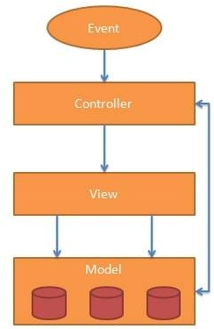
AngularJS MVC Architecture

Slide 31
The MVC pattern is made up of the following three parts:
Model: It is responsible for managing application data. It responds to the requests from view and to the instructions from controller to update itself.
View: It is responsible for displaying all data or only a portion of data to the users. It also specifies the data in a particular format triggered by the controller's decision to present the data. They are script-based template systems such as JSP, ASP, PHP and very easy to integrate with AJAX technology.
Controller: It is responsible to control the relation between models and views. It responds to user input and performs interactions on the data model objects. The controller receives input, validates it, and then performs business operations that modify the state of the data model.

Slide 32


Slide 33
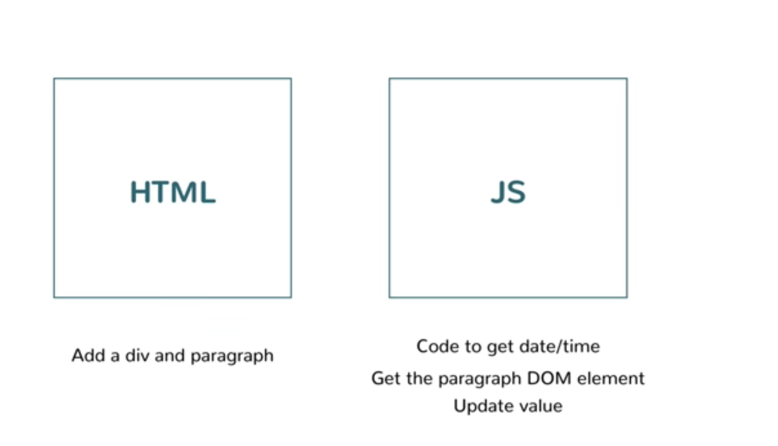

Slide 34
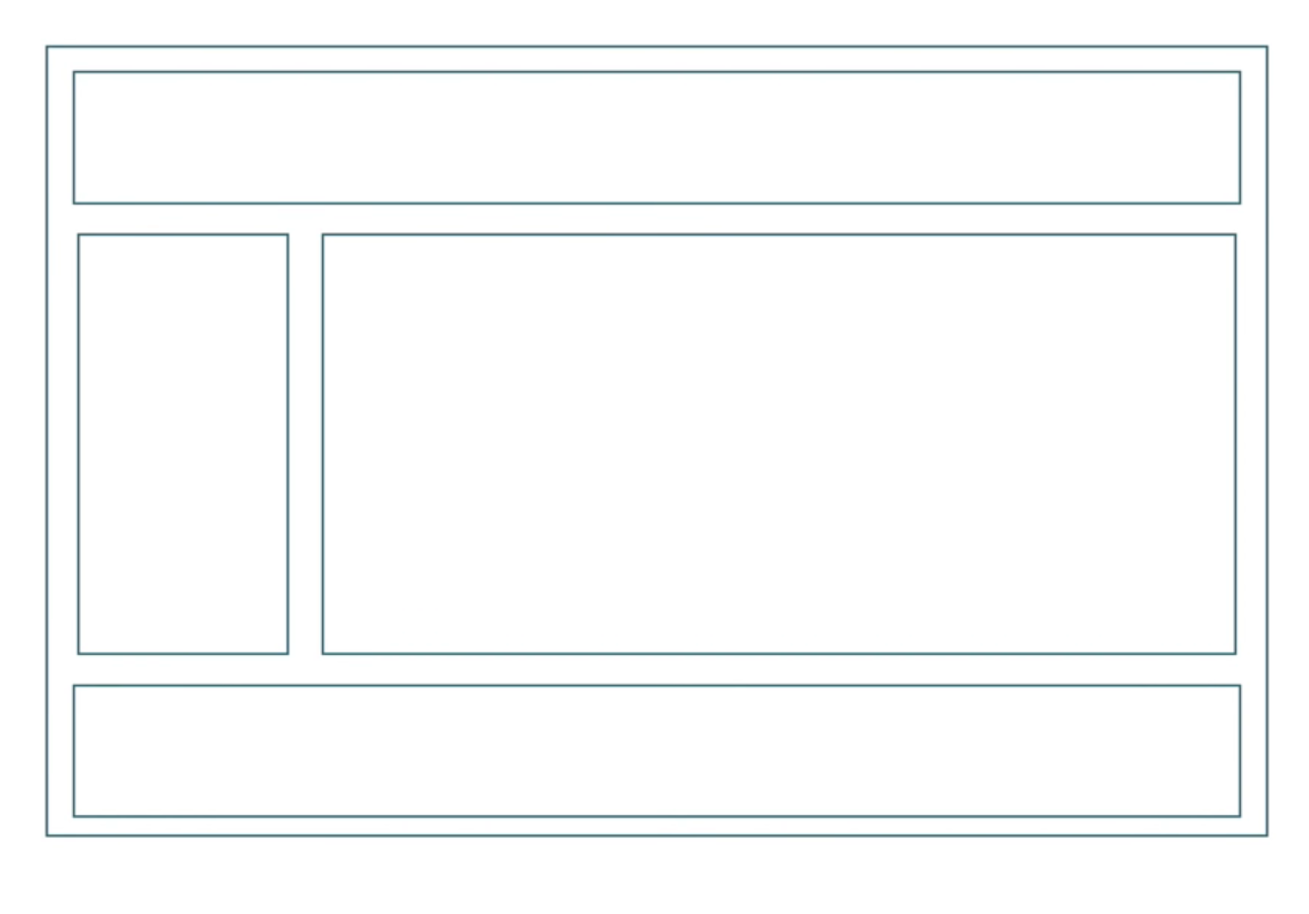

Slide 35
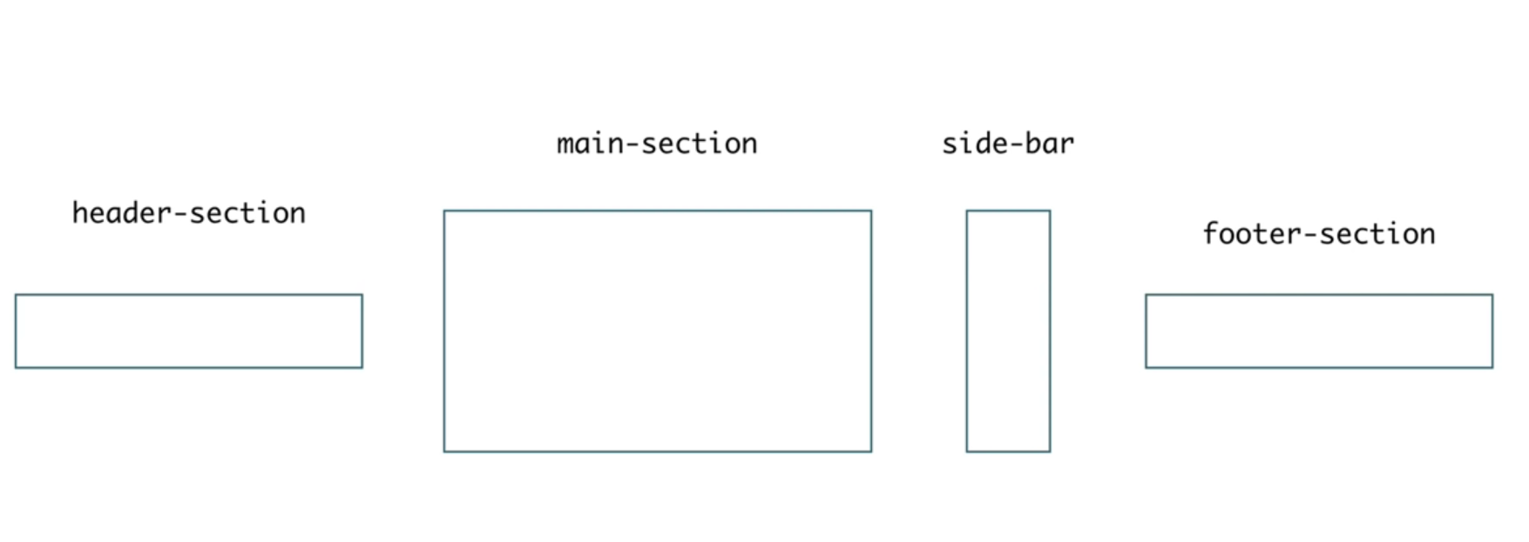
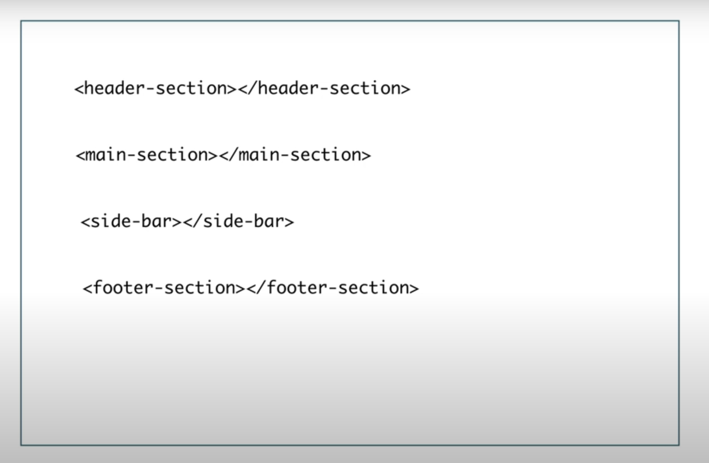

Slide 36
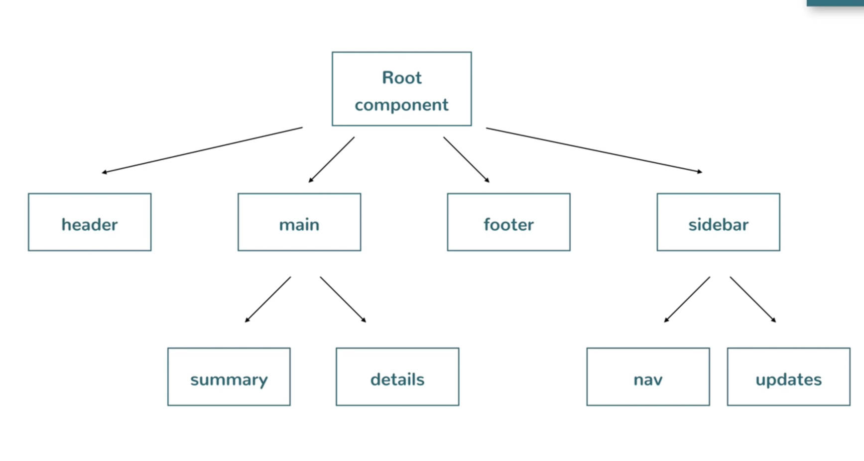

Slide 37
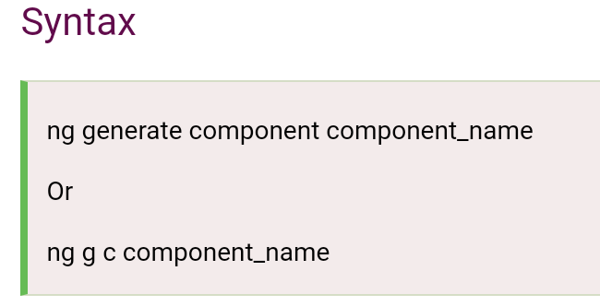
Creating component with CLI
Components are the key features of Angular.
The whole application is built by using different components.

Slide 38
AngularJS Expressions
AngularJS expressions can be written inside double braces: {{ expression }}.
AngularJS expressions can also be written inside a directive: ng-bind="expression".
AngularJS will resolve the expression, and return the result exactly where the expression is written.
AngularJS expressions are much like JavaScript expressions: They can contain literals, operators, and variables.
Example {{ 5 + 5 }} or {{ firstName + " " + lastName }}

Slide 39
<!DOCTYPE html>
<html>
<script src="https://ajax.googleapis.com/ajax/libs/angularjs/1.6.9/angular.min.js"></script>
<body>
<div ng-app>
<p>My first expression: {{ 5 + 5 }}</p>
</div>
</body>
</html>

Slide 40
AngularJS Module
In AngularJS, a module defines an application. It is a container for the different parts of your application like controller, services, filters, directives etc.
A module is used as a Main() method. Controller always belongs to a module.

Slide 41
<!DOCTYPE html>
<html>
<script src="http://ajax.googleapis.com/ajax/libs/angularjs/1.4.8/angular.min.js"></script>
<body>
<div ng-app="myApp" ng-controller="myCtrl">
{{ firstName + " " + lastName }}
</div>
<script>
var app = angular.module("myApp", []);
app.controller("myCtrl", function($scope) {
$scope.firstName = "Ajeet";
$scope.lastName = "Maurya";
});
</script>
</body>
</html>

Slide 42
Angular Directives
Directives are instructions in the DOM. They specify how to place your components and business logic in the Angular.
Directives are js class and declared as @directive. There are 3 directives in Angular.
Component Directives
Structural Directives
Attribute Directives

Slide 43
Directives are special attributes starting with ng- prefix. Following are the most common directives:
ng-app: This directive starts an AngularJS Application.
ng-init: This directive initializes application data.
ng-model: This directive defines the model that is variable to be used in AngularJS.
ng-repeat: This directive repeats html elements for each item in a collection

Slide 44
default AngularJS application using ng-app attribute of a div element.
<div ng-app = "">
...
</div>
ng-init directive
ng-init directive initializes an AngularJS Application data. It defines the initial values for an AngularJS application.

Slide 45
<div ng-app = "" ng-init = "countries = [{locale:'en-IND',name:'India'}, {locale:'en-PAK',name:'Pakistan'}, {locale:'en-AUS',name:'Australia'}]">
...
</div>
ng-model directive:
ng-model directive defines the model/variable to be used in AngularJS Application
<div ng-app = "">
...
<p>Enter your Name: <input type = "text" ng-model = "name"></p>
</div>

Slide 46
<div ng-app = "" ng-init = "countries = [{locale:'en-IND',name:'India'}, {locale:'en-PAK',name:'Pakistan'}, {locale:'en-AUS',name:'Australia'}]">
...
</div>

Slide 47
AngularJS Data Binding
Data binding is a very useful and powerful feature used in software development technologies.
It acts as a bridge between the view and business logic of the application.
AngularJS follows Two-Way data binding model.

Slide 48
Two-Way Data Binding
Data-binding in Angular apps is the automatic synchronization of data between the model and view components.
One-Way Data Binding
The one-way data binding is an approach where a value is taken from the data model and inserted into an HTML element. There is no way to update model from view. It is used in classical template systems. These systems bind data in only one direction.

Slide 49
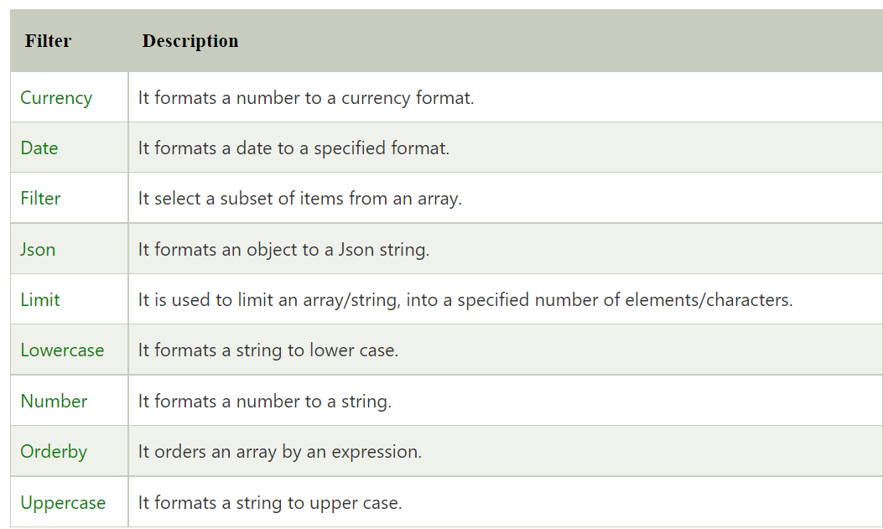
AngularJS Filters
In AngularJS, filters are used to format data.

Slide 50
<!DOCTYPE html>
<html>
<script src="http://ajax.googleapis.com/ajax/libs/angularjs/1.4.8/angular.min.js"></script>
<body>
<div ng-app="myApp" ng-controller="personCtrl">
<p>The name is {{ firstName | uppercase }}</p>
</div>
<script>
angular.module('myApp', []).controller('personCtrl', function($scope) {
$scope.firstName = "Sonoo",
$scope.lastName = "Jaiswal"
});
</script>
</body>
</html>

Slide 51


Slide 52
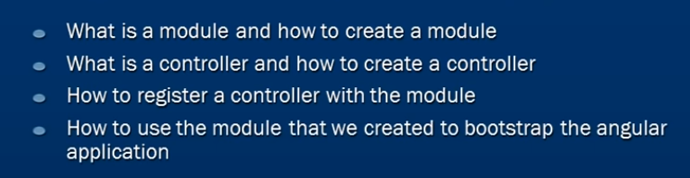

Slide 53
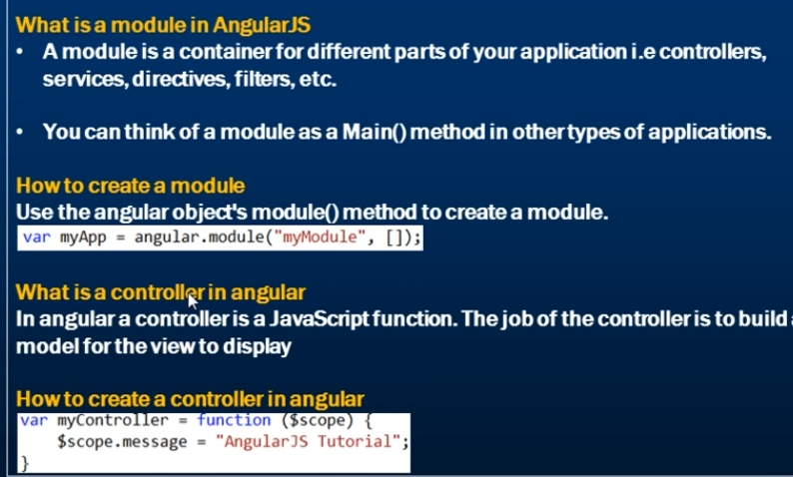

Slide 54
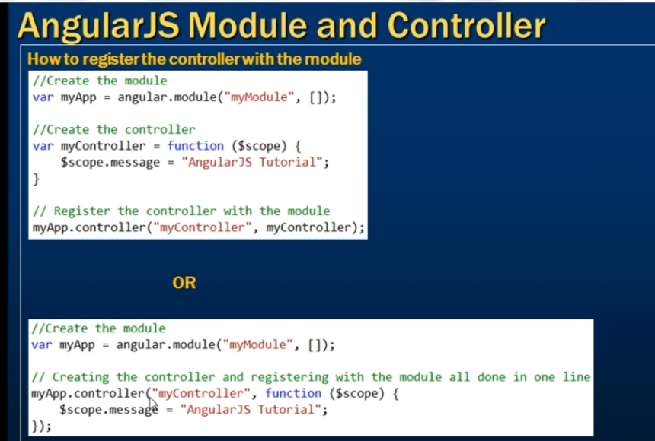

Slide 55
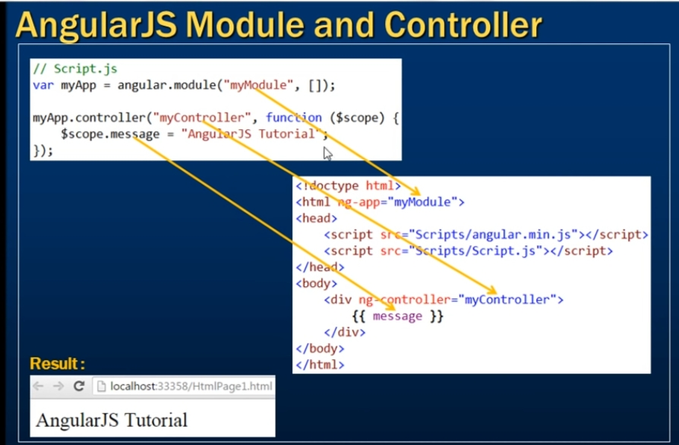

Slide 56


Slide 57
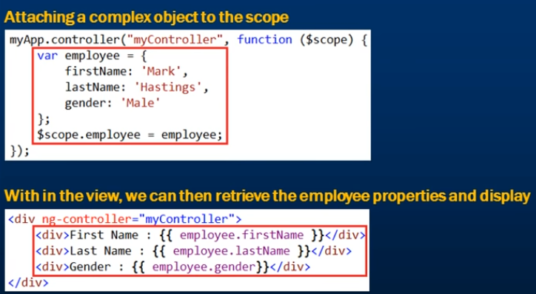

Slide 58
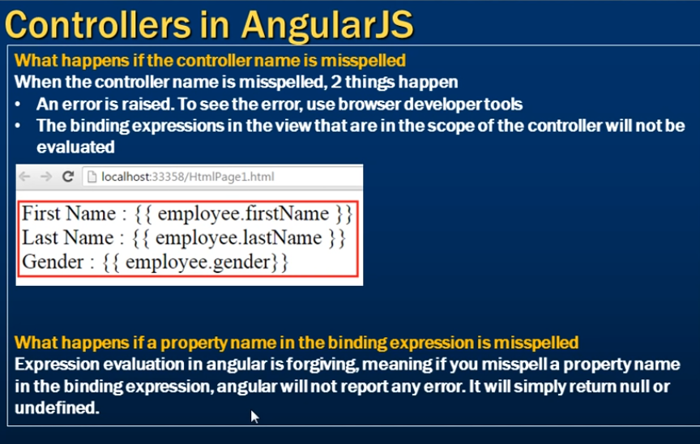

Slide 59
Interaction

Slide 60
AngularJS Events
AngularJS Events are the functionalities that allow web applications to interact with user inputs like mouse click, keyboard inputs, mouse hover, etc. Events need to be handled in web-based applications in order to perform specific tasks and actions.
It is triggered when a specific action is performed by the user.
When creating web-based applications, sooner or later your application will need to handle DOM events like mouse clicks, moves, keyboard presses, change events, etc.
AngularJS can add functionality which can be used to handle such events.

Slide 61
What is ng-click Directive in AngularJS?
The “ng-click directive” in AngularJS is used to apply custom behavior when an element in HTML is clicked.
This directive is normally used for buttons because that is the most commonplace for adding events that respond to clicks performed by the user.
It is also used to popup alerts when a button is clicked.
Syntax of ng-click in AngularJS
<element ng-click="expression"> </element>

Slide 62
<!DOCTYPE html>
<html>
<head>
<meta chrset="UTF 8">
<title>Event Registration</title>
</head>
<body ng-app="">
<script src="https://code.angularjs.org/1.6.9/angular.js"></script>
<script src="https://code.jquery.com/jquery-3.3.1.min.js"></script>
<h1> Global Event</h1>
<button ng-click="count = count + 1" ng-init="count=0">
Increment
</button>
<div>The Current Count is {{count}}</div>
</body>
</html>

Slide 63
What is ng-show Directive in AngularJS?
The ng-Show directive in AngularJS is used to show or hide a given specific HTML element based on the expression provided to the ng-show attribute.
In the background, the HTML element is shown or hidden by removing or adding the .ng-hide CSS class onto the element.
It is a predefined CSS class which sets the display to none.

Slide 64
<!DOCTYPE html>
<html>
<head>
<meta chrset="UTF 8">
<title>Event Registration</title>
</head>
<body>
<script src="https://code.angularjs.org/1.6.9/angular.js"></script>
<script src="https://code.jquery.com/jquery-3.3.1.min.js"></script>
<h1> Guru99 Global Event</h1>
<div ng-app="DemoApp" ng-controller="DemoController">
<input type="button" value="Show Angular" ng-click="ShowHide()"/>
<br><br><div ng-show = "IsVisible">Angular</div>
</div>
<script type="text/javascript">
var app = angular.module('DemoApp',[]);
app.controller('DemoController',function($scope){
$scope.IsVisible = false;
$scope.ShowHide = function(){
$scope.IsVisible = true;
}
});
</script>
</body>
</html>

Slide 65
AngularJS Event Listener Directives
You can add AngularJS event listeners to your HTML elements by using one or more of these directives:
ng-blur
ng-change
ng-click
ng-copy
ng-cut
ng-dblclick
ng-focus
ng-keydown
ng-keypress
ng-keyup
ng-mousedown
ng-mouseenter
ng-mouseleave
ng-mousemove
ng-mouseover
ng-mouseup
ng-paste

Slide 66
THANK YOU …

